Slide 1
Dimensionality Reduction of Polymer Nanocomposites
Alicia Rossi
Jason Allen
CSE 8803-MIP

Slide 2
Overview
Background
Datasets
Image Segmentation
Dimensionality Reduction
Conclusions

Slide 3
Background

Slide 4
Datasets

Slide 5
Image Segmentation

Slide 6
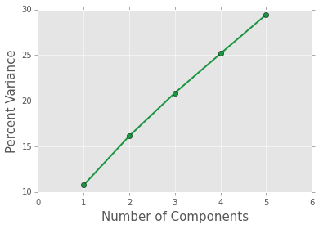
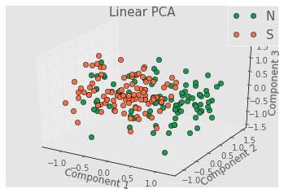
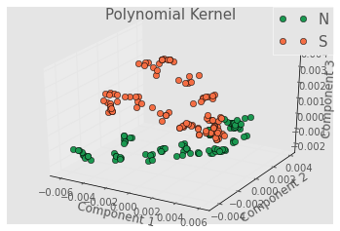
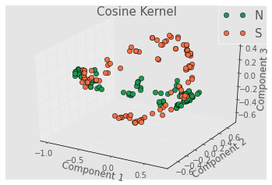
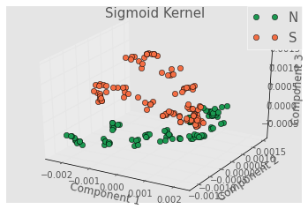
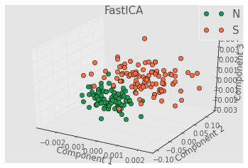
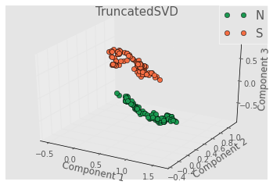
Dimensionality Reduction of the Structure

Slide 7
Dimensionality Reduction of Properties

Slide 8
Linking the Models

Slide 9
Conclusions

Slide 10
References

